Slide 1
Project Name
Supermarket performance analysis

Slide 2
Overview
Supermarket Sales Analysis involves examining sales data to identify patterns, trends, and areas for improvement in a retail setting. The analysis typically covers aspects such as sales volume, revenue, product performance, and customer demographics. It helps in understanding which products sell the most, peak sales times, and how promotions impact revenue. Insights gained from the analysis can guide inventory management, optimize product placement, and shape marketing strategies to maximize profitability and enhance the customer experience.

Slide 3
Applications

Slide 4
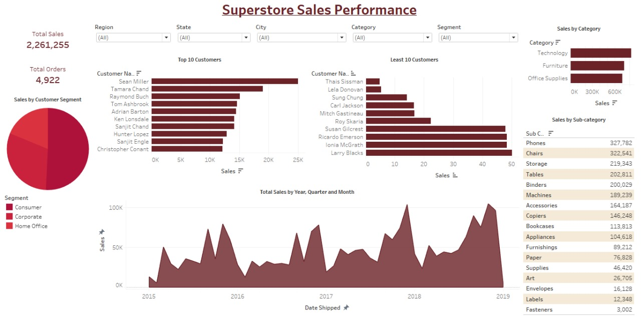

Slide 5
Findings
Pervious dashboard discusses clarifying the below points
Total sales / total orders /sales per customer segment /total sales on yearly , quarterly and monthly basis
Differentiating each product category /sub categories
Top customer who are dealing with us and least customer

Slide 6
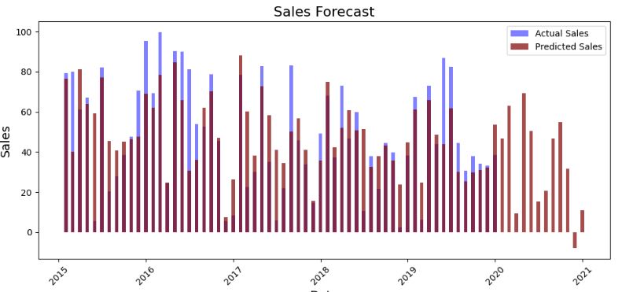
Actual vs predicted sales clarifying the potential sales for a determined duration

Slide 7
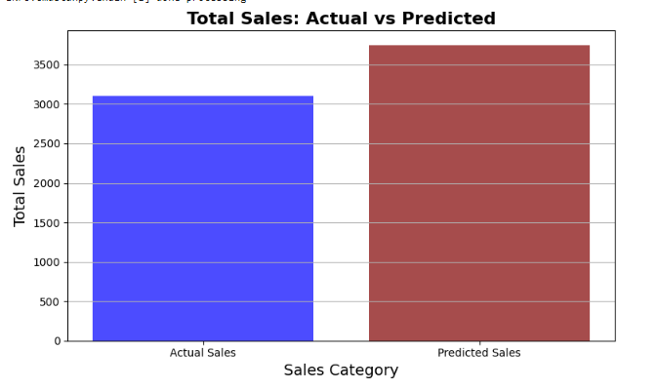
Actual vs predicted sales
It was shown that predicted sales were beyond the actual sales

Slide 8
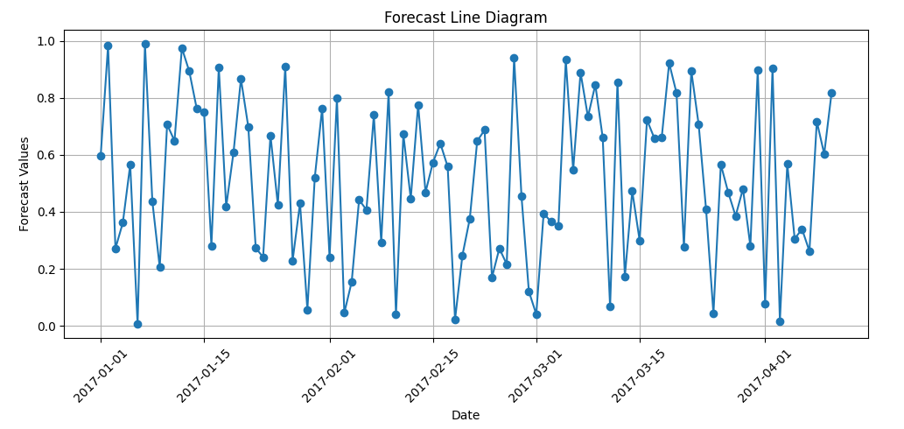
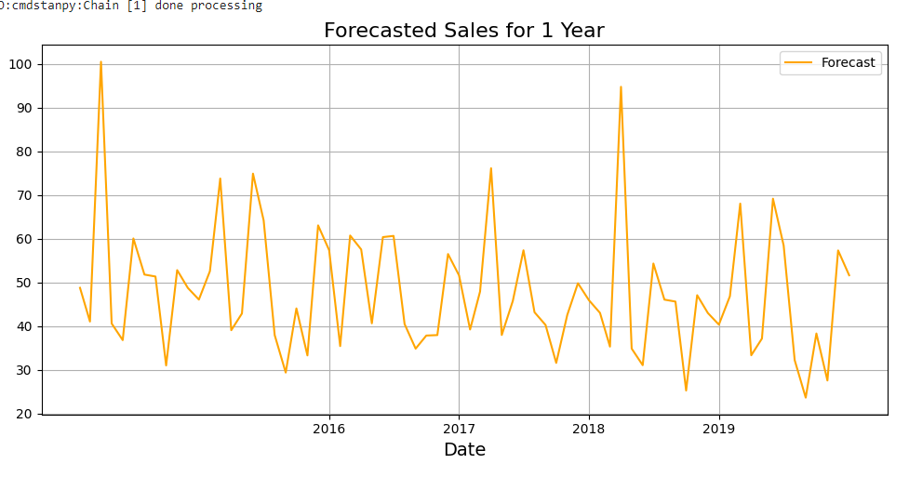
Forecast sales for 100 days / next year

